Slide 1

Hold my catnip, I’m Pouncing Over APTs for Purple Teaming
Katie Chuzie, Andrei Saygo and Jesse Zhang
Notes:
kc
<number>

Slide 2

Disclaimer
If you have ailurophobia, we wanted to let you know that we will have cats
P.S. Do not use the ideas/code/cats presented here for malicious purposes
Notes:
kc
<number>

Slide 3



$ WHOArewe
Katie Chuzie
Software Engineer (Red Team)
Microsoft
Jesse Zhang
Software Engineer (Red Team)
Microsoft
Andrei Saygo
Senior Software Engineer (Red Team)
Microsoft
Notes:
Brief introductions and professional background info (all)
<number>

Slide 4
Why are you here?
Cats
Purple Teaming
C2 (Command and Control)
APT (Advanced Persistent Threat)
TTPs (Tactics, Techniques, and Procedures)
Notes:
So today we’ll be discussing the following:
-We will be showing a lot of cats.
-We’ll introduce the concept of purple teaming and how we practice it at Microsoft.
-We’ll talk briefly about how a C2 works and the C2 infrastructure we’ve implemented.
-We’ll then discuss the APT research we’ve done and how we’ve implemented many TTPs to achieve APT emulation.
So why are you all here?
Maybe you just really like cats.
Maybe you want to learn about purple teaming.
Perhaps you want to learn how to make your own C2 or how a C2 infrastructure works.
Maybe you’re doing APT emulation or want to learn more about advanced persistent threats and the many TTPs they use in their attacks.
Well, today we will be talking to you about all of it.
<number>

Slide 5

Purple teaming
Notes:
So to start off, let’s talk about purple teaming.
kc
<number>

Slide 6
Purple teaming – What?
Purple teaming is a security methodology whereby red and blue teams work closely together to maximize cyber capabilities through continuous feedback and knowledge transfer.
https://www.redscan.com/news/purple-teaming-can-strengthen-cyber-security/
Notes:
What is purple teaming?
I’ll let you all read the formal definition, but basically it’s a methodology where the red and blue team come together and share knowledge with the ultimate goal of making each other better. For those who aren’t familiar with the concept of red and blue team, the red team impersonates real attackers and actively tries to break into systems whereas the blue team is monitoring attacker activity and trying to detect and evict them from environments.
kc
<number>

Slide 7
Purple teaming – How?
Red team
Issues attacks against test environment
Improves evasion tactics
Blue Team
Monitors attacks and looks for triggered alerts
Improves detections
Notes:
So what does a typical purple teaming exercise look like for us?
The red team issues attacks against test environments that we stand up specifically for this exercise and their goal is to see how they get detected and improve their evasion tactics.
The blue team, on the other hand, monitors red team attacks and looks for any alerts that may fire. This allows them to see gaps in their detections and make improvements.
kc
<number>

Slide 8
Purple teaming – our solution
We have created a tool (CopyCat) to make this process more efficient
C2 infrastructure
In-depth APT (Advanced Persistent Threat) research
APT tactics, techniques, and procedures (TTPs) implementation
Extensible modules
Notes:
So how does purple teaming fit into this talk?
We wanted to improve this process therefore we created a tool called CopyCat to help us achieve this.
It has a built-in C2 infrastructure.
We’ve done in-depth APT research which has helped us to implement many APT tactics, techniques and procedures to achieve APT emulation.
And we’ve also implemented many custom modules to assist our APT campaigns.
kc
<number>

Slide 9
Purple Teaming - Utilizing c2 for apt emulation
We're already using it in our engagements
Easy to deploy binaries targeting various APT groups
Run specific commands for a specific APT profile
Notes:
Now, I’ll hand it off to Jesse to talk about our C2.
Jz
<number>

Slide 10
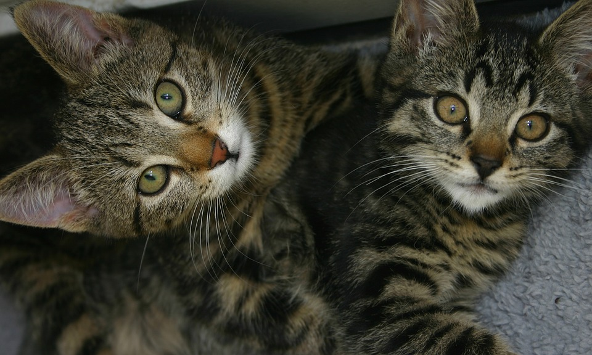
C2 – copycat
Notes:
jz
<number>

Slide 11








C2 infrastructure overview
Victim
Attacker
Compromised Machine
C2 Traffic
Notes:
jz
<number>

Slide 12
Build Your Own C2 – why golang ?
Main reasons:
Runs (almost) everywhere (including Raspberry PI)
It's simple(-ish)
It's fast
Notes:
jz
<number>

Slide 13
Build Your Own C2 – Recipe
ingredients:
1 x TCP Listener
1 x infinite Loop to accept connections
1 x thread/connection to handle the client/zombie/implant
directions:
Read the command from stdin/wss
Bake the command until it's ready (Check if it needs to run through a shell, if it's an internal command, etc)
Send the command to the zombie
Read the incoming data
Notes:
jz
<number>

Slide 14
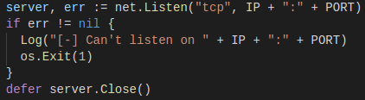
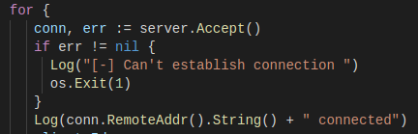
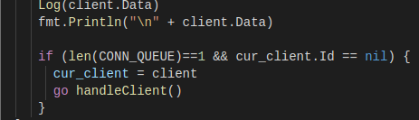
Build Your Own C2 – ingredients
1 x TCP Listener
1 x Infinite Loop
1 x Zombie Wrangler
Notes:
jz
<number>

Slide 15
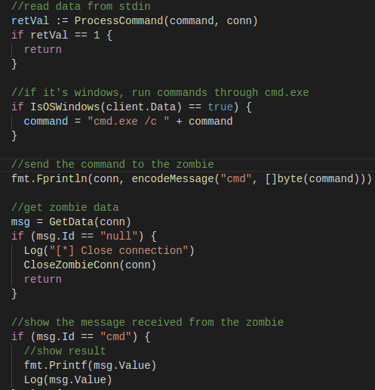
Build Your Own C2 – directions
directions:
Read the command from stdin/wss
On windows, run the command through cmd.exe
Encode the command and send it to the zombie
Read the incoming data and display it
Notes:
jz
<number>

Slide 16

APT research
Notes:
Kc, what did the cat say when it was confused? I am purrrrr-plexed!
<number>

Slide 17
APT Research – find campaigns
Twitter
Blogs/RSS feeds
Threat Intel
Security Operations Center (SOC)
VirusTotal (samples)
Hybrid-Analysis (samples)
MalShare (sampes)
GitHub (reports)
Blogs (reports)
Notes:
kc
<number>

Slide 18
Apt research – emulation
Automatic IOC (Indicator Of Compromise) extraction from various RSS feeds/blogs (file names and registry keys)
Manual analysis of reports to extract IOCs (e.g. file names, registry keys, domain names, etc)
Reverse Engineer samples and implement similar techniques without a malicious payload
Notes:
kc
<number>

Slide 19
















Threat Actor
Apt Research – implementation
Profile
Commands
Tools
Readme
Notes:
kc
<number>

Slide 20
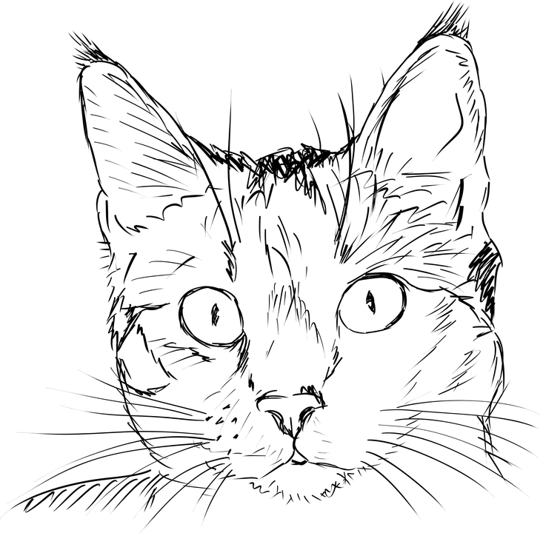
Apt profiles
In-depth profile discussion
Discuss campaigns
Notes:
kc
<number>

Slide 21

APT profile – Turla darkneuron (macro)
Spearphish: Saudi Arabia Gov Org
Emulate initial entry
Implement macro dropper code
Implement specific IOCs
Notes:
kc
<number>

Slide 22
APT profile – turla darkneuron (macro)
Living off the land decoder
Notes:
kc
<number>

Slide 23
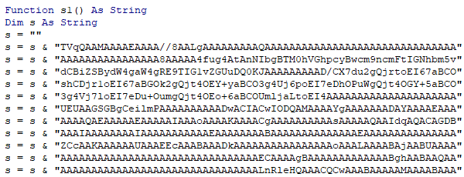
APT profile – turla darkneuron (macro)
Base64 encoded payload
Notes:
kc
<number>

Slide 24
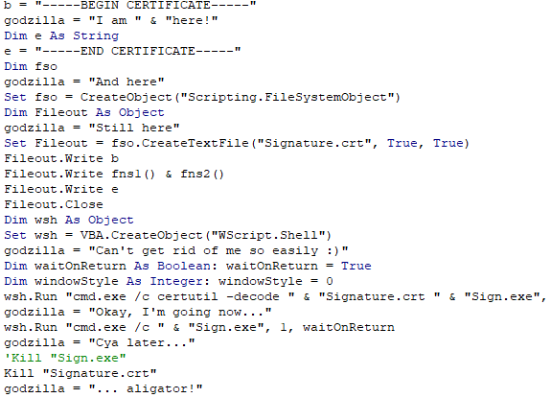
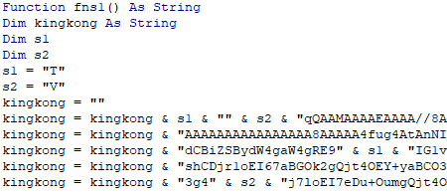
APT profile – turla darkneuron (macro) evasion
Notes:
kc
<number>

Slide 25
APT profile – turla darkneuron (.net payload)
First known backdoor for microsoft exchange servers
Uses dll sideloading to be loaded into the address space of microsoft exchange application
Notes:
jz
<number>

Slide 26
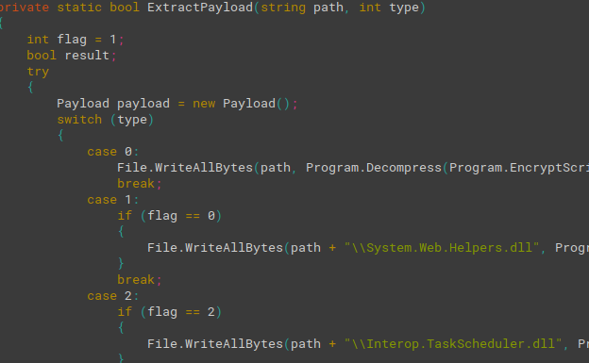
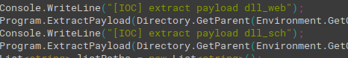
Apt profile – turla darkneuron (.net payload)
Uses the "original" declawed .NET code with several modifications
Notes:
jz
<number>

Slide 27
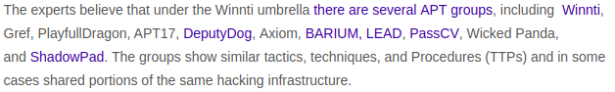
Apt profile – linux WINNTI backdoor
Emulate backdoor functionality
Implement unique functions pertaining to winnti
Implement specific IOCs
https://securityaffairs.co
Notes:
as
<number>

Slide 28
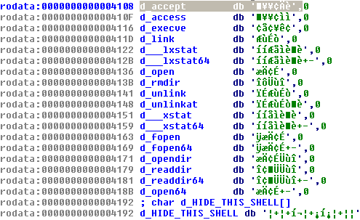
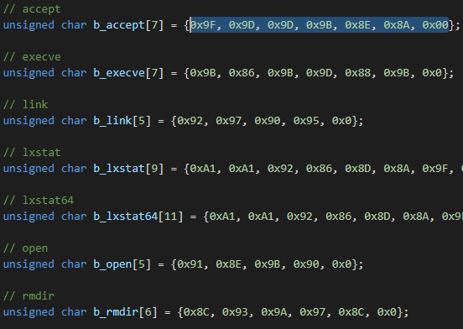
Apt profile – linux WINNTI backdoor
Encrypted API names
Notes:
as
<number>

Slide 29
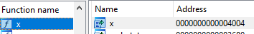
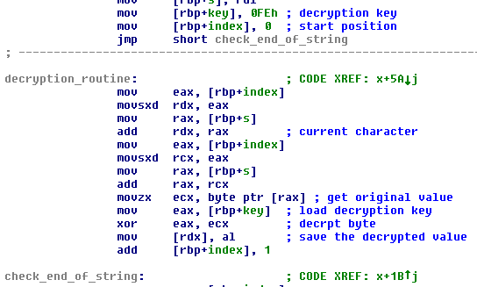
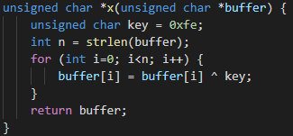
Apt profile – linux WINNTI backdoor
String decryption function - "x(unsigned char *buffer)"
Notes:
as
<number>

Slide 30
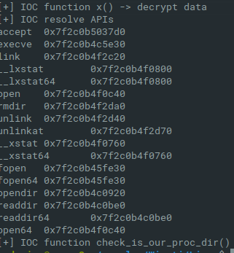
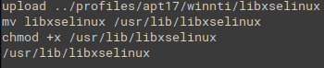
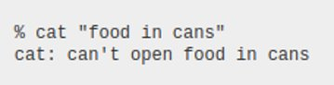
apt profile – linux WINNTI backdoor
Run profile commands
Notes:
as
<number>

Slide 31
Apt profile – cannon
Uses e-mail as a C2 channel to decrease chance of detection.
Goals:
Emulate backdoor functionality
Emulate pop3 and smtp comms
Implement specific IOCs
Notes:
as
<number>

Slide 32
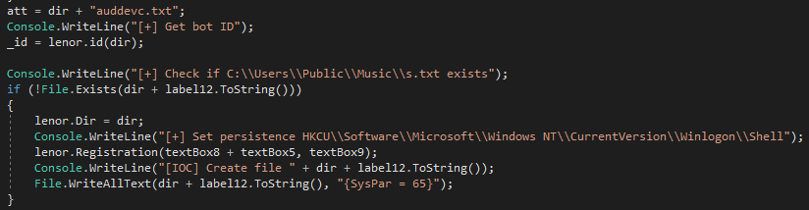
Apt profile – cannon
Notes:
as
<number>

Slide 33
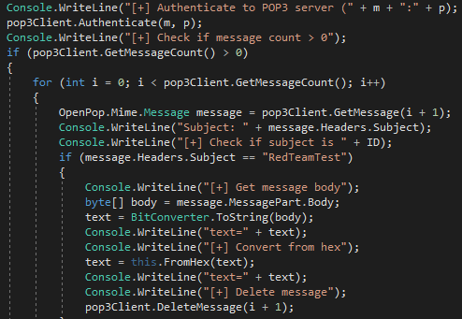
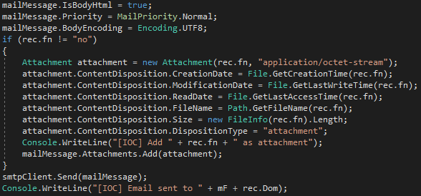
Apt profile – cannon
Check for e-mail with specific subject in POP3 mailbox
Send data through SMTP
Notes:
as
<number>

Slide 34
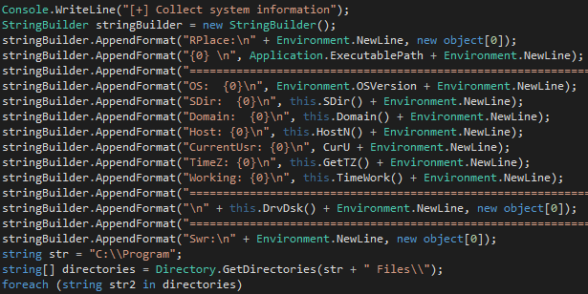
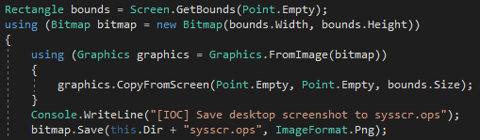
Apt profile – cannon
OS Info
Screenshots
Notes:
as
<number>

Slide 35
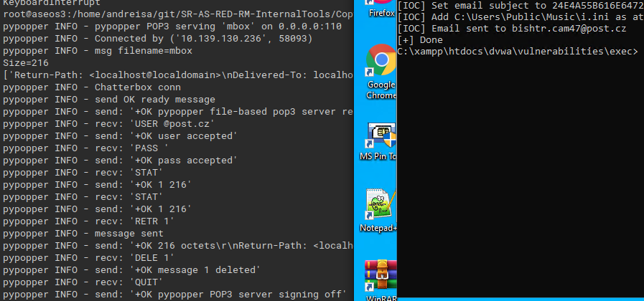
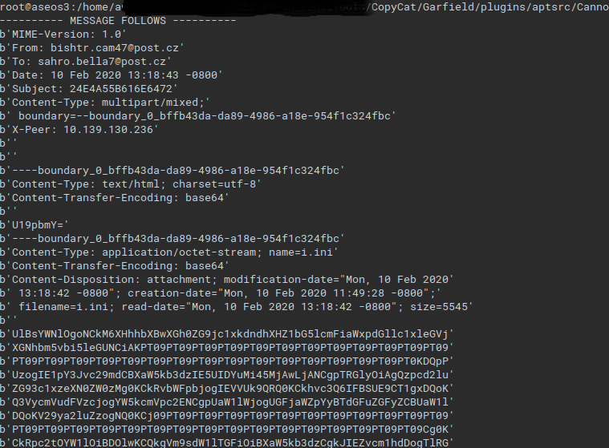
Apt profile – cannon
Connect to POP3 mailbox
Send data through SMTP
Notes:
as
<number>

Slide 36
Apt profile – aVEMARIA
Reportedly attributed to the FIN7 group
Goals:
Emulate UAC bypass functionality
Implement specific IOCs
Notes:
as
<number>

Slide 37
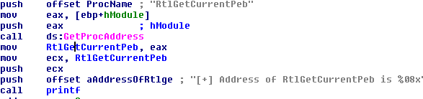
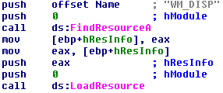
Apt profile – aVEMARIA
Resolve APIs
Drop file from resources
Notes:
as
<number>

Slide 38
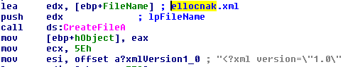
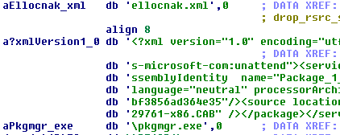
Apt profile – aVEMARIA
UAC bypass: pkgmgr.exe -> dism.exe -> dismcore.dll
Notes:
as
<number>

Slide 39

Demo
Notes:
kc
<number>

Slide 40
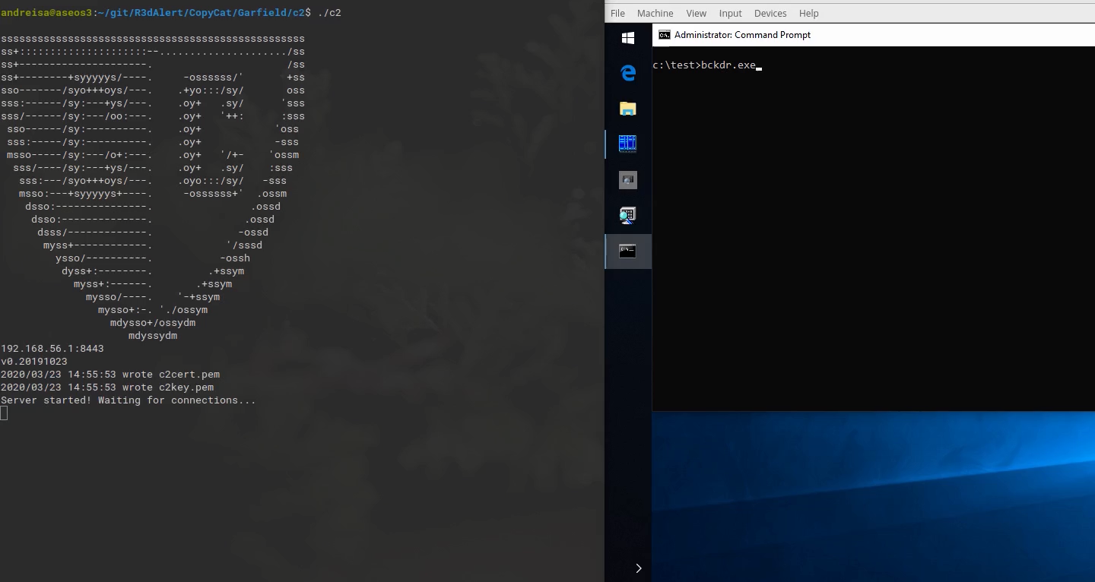

Slide 41
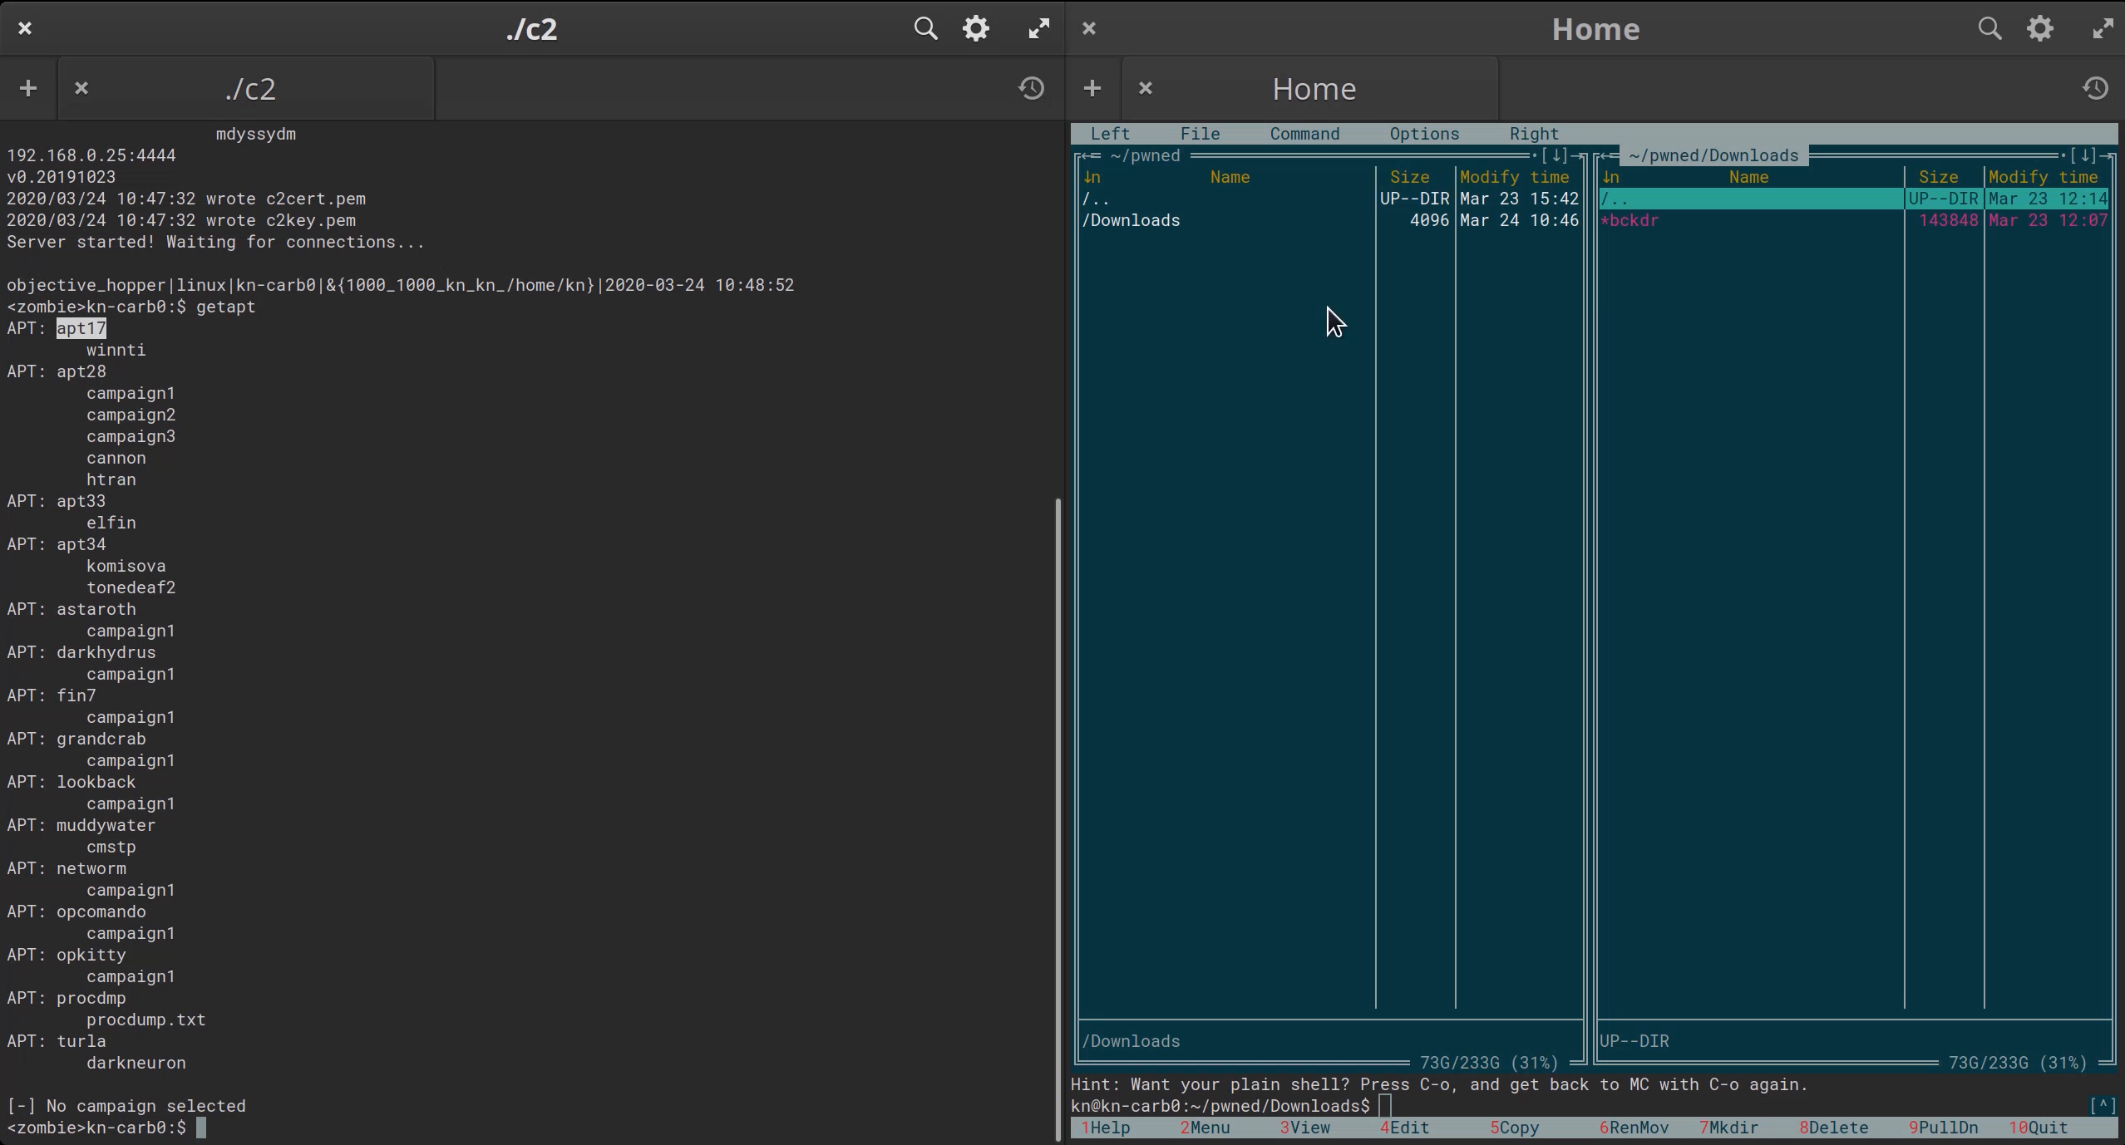

Slide 42
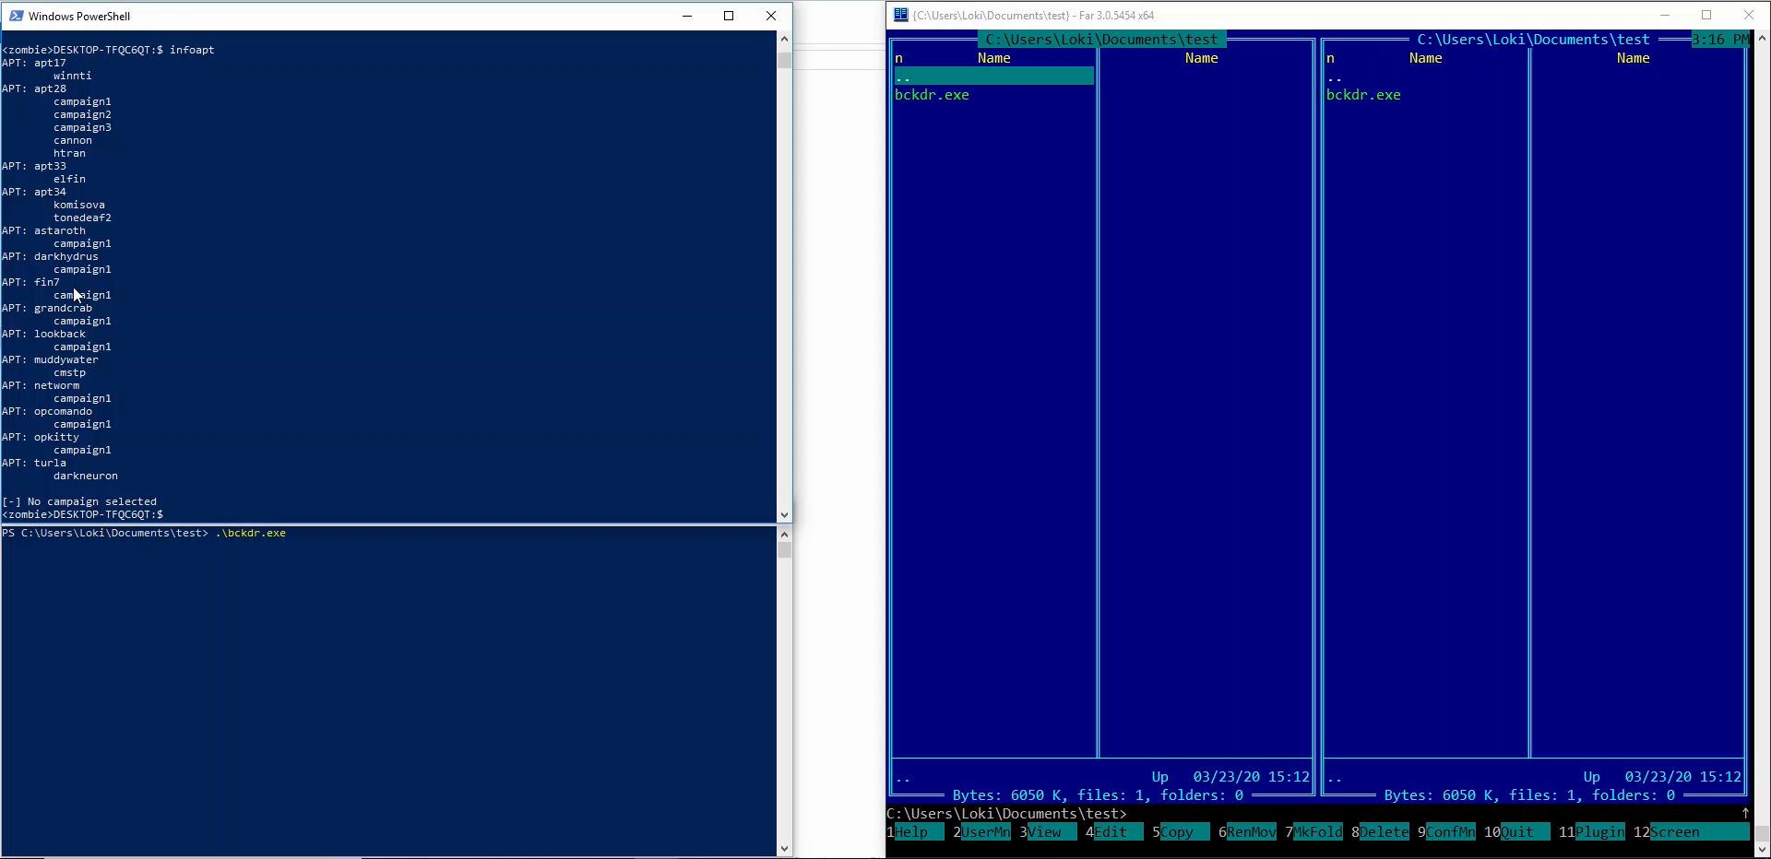

Slide 43

Questions?
Notes:
Jz, wanna hear a bad cat joke? Just kitten!
<number>

